Slide 1

Book Tracker App: Personalized Book Recommendations
Wentao Dong

Slide 2

Problem Statement
Difficulty managing reading progress and feelings
The quality of book recommendations varies
Many readers forget which books they have read, where they were in the book, how they felt about the book, and even which books are still on their to-read list.
There are a large number of book recommendation sources on the market, but most of them are not customized based on personal reading preferences, and users need to spend a lot of time screening suitable books from the book list.
Book Tracker
-Simple and efficient book management tool
-Personalized book recommendation system

Slide 3

Target Audience
Core users: Ryan
He likes to discover new books but often forgets his reading progress. He hopes to have a tool to help him manage his book lists, record book reviews, and get recommendations that suit his interests.
Avid Readers
I read habitually, but I read a lot and tend to forget which books I have read.
I need an integrated book management tool instead of manually recording the book list in notes or Excel.
Students & Researchers
You need to keep track of professional books and papers, mark key points, and record study notes.
Pain Point Summary
-No proper tools to manage reading
-Book recommendations are not accurate

Slide 4


Competitor Analysis
Goodreads
BookBub
summary
Combining their advantages, it provides a simple and intuitive interface, focusing on user experience and avoiding endless browsing.
Advantages: Provide book ratings and reviews.
Advantages: Provide personalized book recommendations and often have discounts.
Disadvantages: Lack of personalized recommendations.
Disadvantages: Lack of book tracking and user interaction features.

Slide 5
Proposed Features
1. Book log: Users can record the books they have read.
2. Personalized recommendation system: Push book recommendations based on reading history.
3. Book ratings and reviews: Users can rate and review books.
4. Book classification and tags: Detailed recommendations through tags.

Slide 6
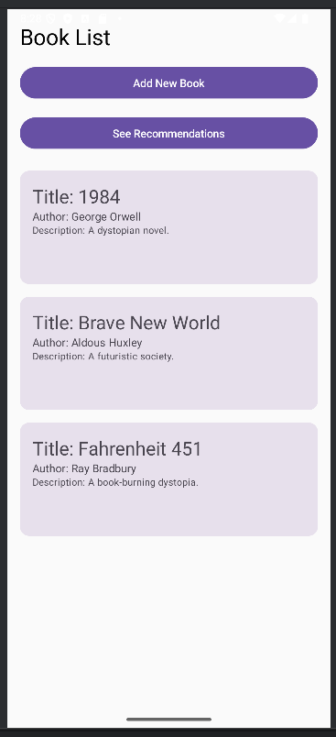
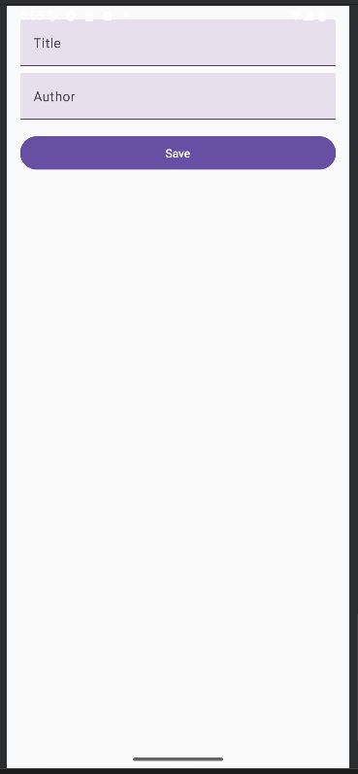
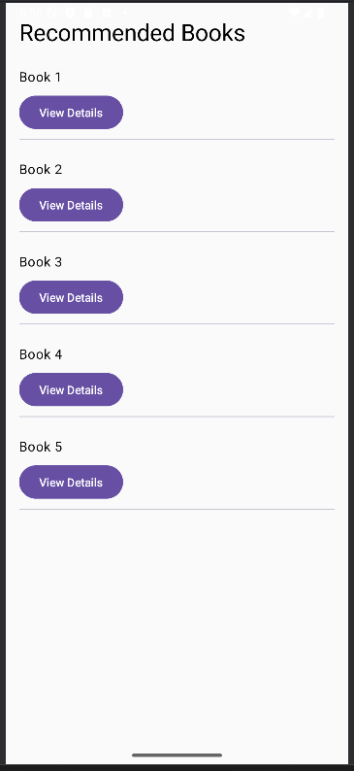

UI Mockups & Design
Home Screen
Add Book Screen
Recommendations Screen
Book Detail Screen

Slide 7
Design Decisions
Use LazyColumn to display the book list (better performance, suitable for long lists)
Use Card component to make the book items more beautiful and easy to click
Use ElevatedButton to make user operation more intuitive
Use TextField to let users enter the book name and author information

Slide 8
User Flow
The user opens the app and enters the Home Screen
Click “See Recommendations”
(See the books recommended by the system, select one to enter the details page)
Click “Add New Book” to add a book
(After filling in the title and author, click Save and the book will be added to the list.)
Click on a book to enter the book details page
(View detailed information about books, including title, author, rating, etc.)

Slide 9
Key Jetpack Compose components
module | effect
LazyColumn | Display book lists and recommended books
Card | Display each book beautifully
Text | Display book titles and authors
Button | Trigger actions such as adding books, viewing recommendations, etc.
TextField | Allow users to enter book information

Slide 10
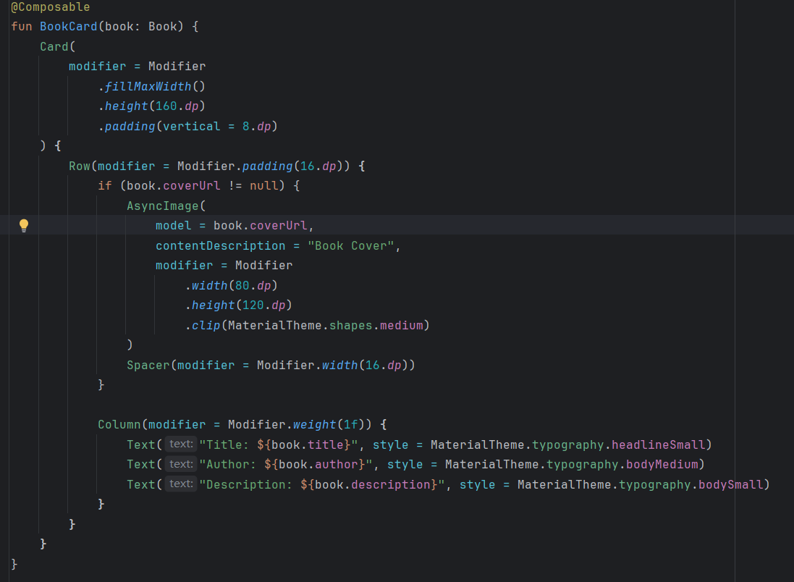
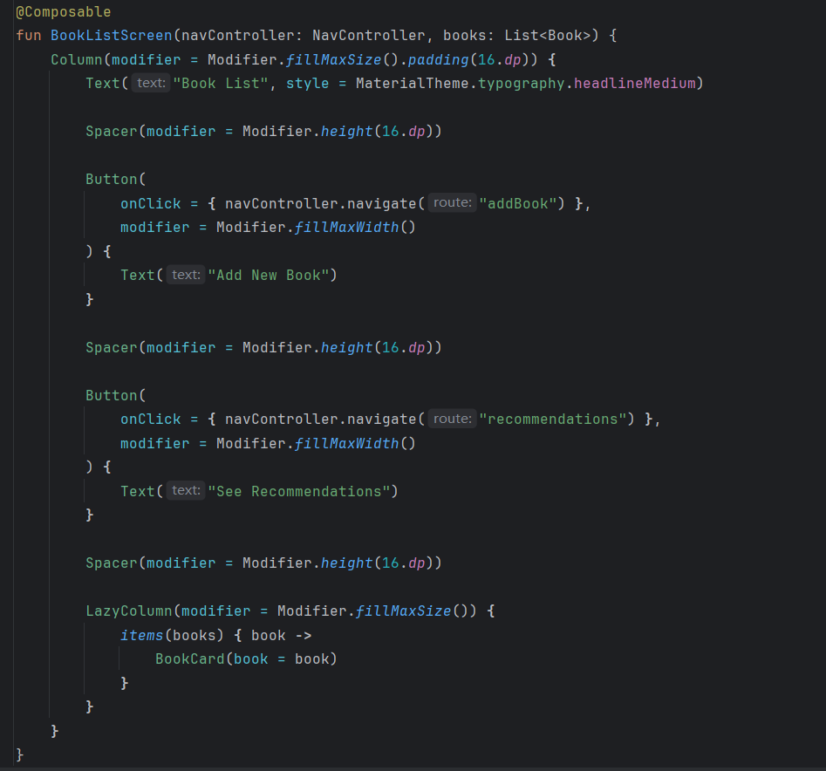
Code Snippet
Card: Make the book items uniform in style.
fillMaxWidth(): Fill the screen width to ensure alignment.
padding(16.dp): Optimize spacing to prevent content crowding.
AsyncImage loads cover images.
Row + Column: Reasonable layout.
Code Example 1:
Code Example 2:
What this code does:
LazyColumn: displays books added by
Users
BookCard: used to display book
informationButton: users to click to enter the book adding interface

Slide 11
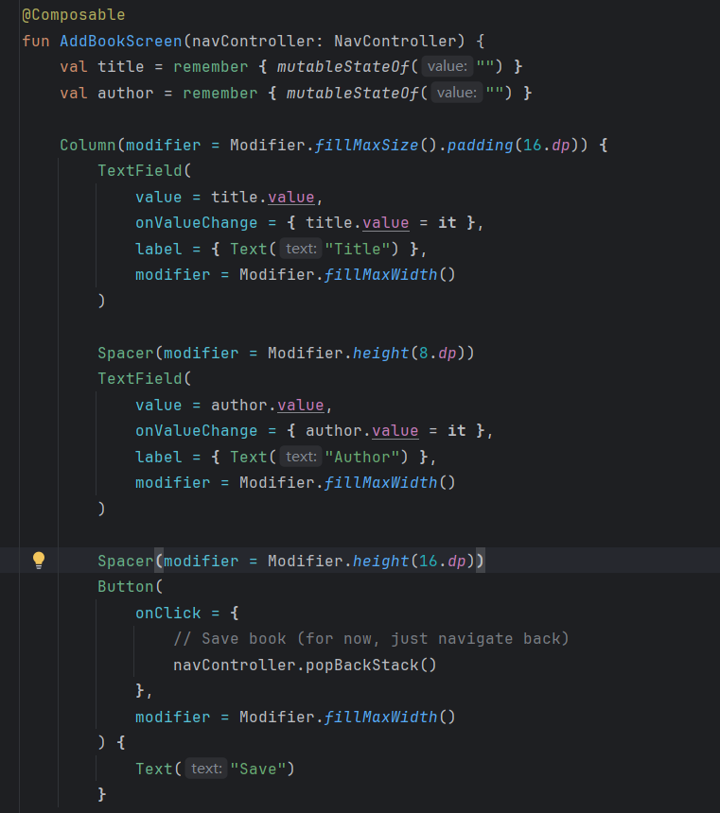
Code Snippet
Code Example 3:
What this code does:
TextField: allows users to enter the book title and author
Button: allows users to click to save the book
Remember: handle the input state

Slide 12
Timeline & Milestones
Development plan:
Phase 1: Determine the theme and analyze the project , complete the project structure and basic page layout.(3 weeks)
Phase 2: Core function development. Improve data transfer in NavGraph and add data processing and functions.(4 weeks)
Phase 3: Improve UI design and conduct testing and debugging. (3 weeks)

Slide 13
GitHub Repository & Version Control
GitHub Repository : https://github.com/187194241/3406
Version Control Strategy: As I complete each stage of work I commit it to the GitHub repository.

